Slide 1
Dialogue for practicing the present tense and pronouns with direct object marker.
Featuring riksina (to know by experience);
pushana (to lead);
katina (to follow)
Begin by translating each slide into English.
\

Slide 2
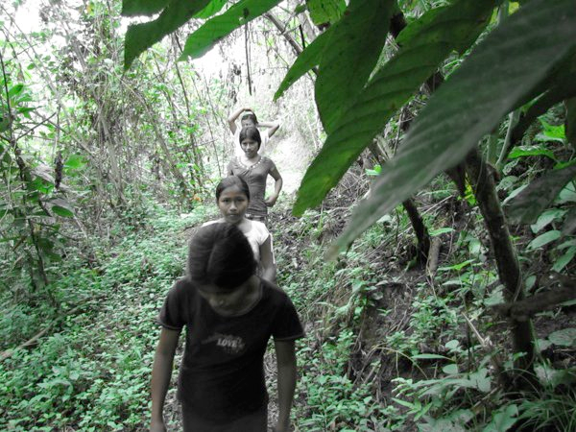
Maymara riungichi?

Slide 3
Where are you going?

Slide 4
Sachama

Slide 5
To the forest

Slide 6
Pita ñambira riksin?

Slide 7
Who knows the path?

Slide 8
Ñambita riksingichu?

Slide 9
Do you know the path?

Slide 10
Ari. Ñambita riksinimi.

Slide 11
Yes. I know the path.

Slide 12
Pitara kati-u-ngichi.

Slide 13
Who are you following?

Slide 14
Payta kati-u-nchi.

Slide 15
We are following her.

Slide 16
Pitara pushaungi?

Slide 17
Who are you guiding?

Slide 18
Paygunara pushauni.

Slide 19
I am leading them.

Slide 20
Pitara katinun?

Slide 21
Who are they following?

Slide 22
Ñukara katinun.

Slide 23
They are following me.

Slide 24
Now translate the same slides from English into Kichwa.
\

Slide 25
Where are you going?

Slide 26
Maymara riungichi?

Slide 27
To the forest

Slide 28
Sachama

Slide 29
Who knows the path?

Slide 30
Pita ñambira riksin?

Slide 31
Do you know the path?

Slide 32
Ñambita riksingichu?

Slide 33
Yes. I know the path.

Slide 34
Ari. Ñambita riksinimi.

Slide 35
Who are you following?

Slide 36
Pitara kati-u-ngichi.

Slide 37
We are following her.

Slide 38
Payta kati-u-nchi.

Slide 39
Who are you guiding?

Slide 40
Pitara pushaungi?

Slide 41
I am leading them.

Slide 42
Paygunara pushauni.

Slide 43
Who are they following?

Slide 44
Pitara katinun?

Slide 45
They are following me.

Slide 46
Ñukara katinun.

