Slide 1
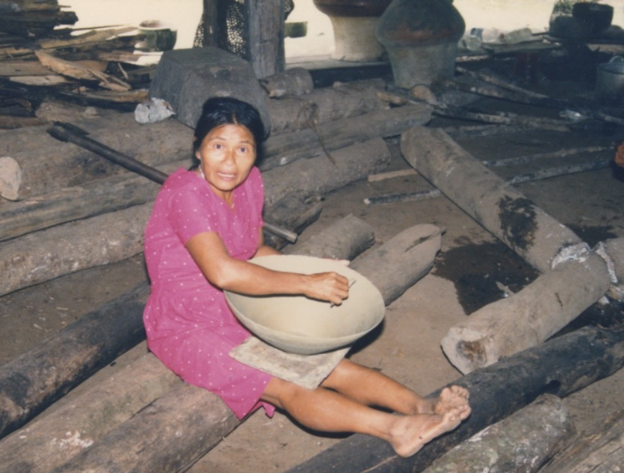
The attributive –k
This lesson introduces a very important suffix. It is a bit like the –er suffix in words like ‘do-er’, ‘go-getter’, etc. However it is used far more by Quichua speakers than the –er suffix is used in English.
The attributive –k suffix attributes a certain role, ability, activity, or characteristic trait to the subject of its verb.
What is attributed by the use of –k does not have to be an essential or defining quality.
tinaha awag warmi

Slide 2
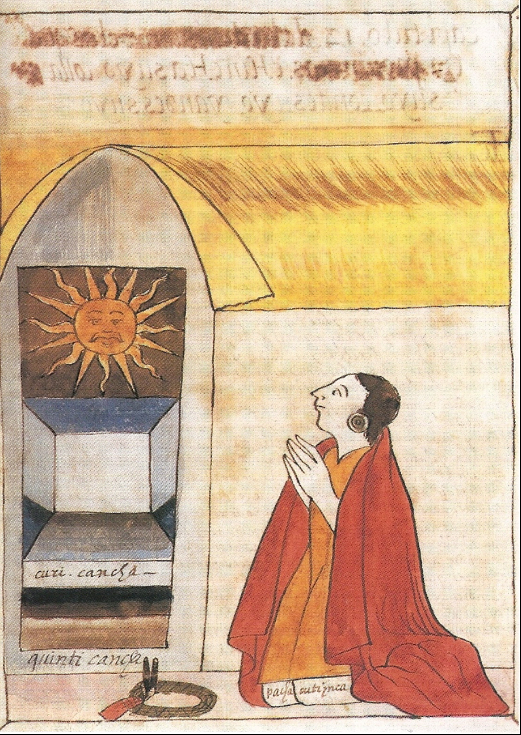
The attributive –k is used twice in the title of one of the most famous Inca rulers
Pachakutiq Inka Yupanki, Wakcha Khuyaq (wakcha kuyak) Huaccha ccuyac, que dice "amoroso de los pobres,"Huaccha ccuyac, que dice "amoroso de los pobres,"
… porque les quería dar á entender, que por prósperos que fuesen, habían de tener en mucho á los que tenían no tanto, porque, al fin, podría ser posible que el que al presente se veía en prosperidad, que podría perderse, y el otro que no tenía tanto, estar aumentado en bienes y le podría socorrer; y porque siempre tuviesen una hermandad y confederación, daba aquella orden é aquella manera. É que de allí adelante, que demás del nombre que de Señor tenía, el sobrenombre que ellos y los demás le nombrasen cada y cuando que con él alguno hablase, que le nombrasen Huaccha ccuyac, que dice "amoroso de los pobres," de la cual institución, los demás sus descendientes ansí se intitularan.
ama a los pobres como a ti mismo
kikiykitahina wakchata khuyay
Juan de Betanzos (sobre Pachakutiq Inka Yupanki) .

Slide 3
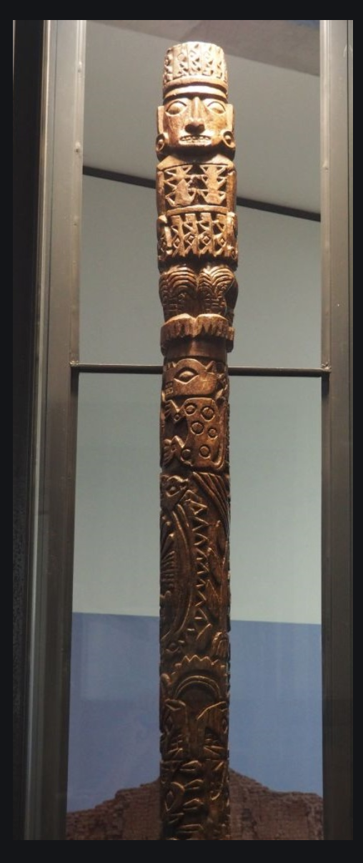
The attributive –k was also used as a title for the “amus” “dueños” or spiritPacha kamak Pacha-Earth Kamana- to measure or put in order. kamachina- to advise

Slide 4
katuna= to sell
A seller (or sales woman)

Slide 5
katuna = to sell
katuk

Slide 6
Written Exercise 1
Using the attributive construction construct ten sentences to describe yourself. The way you describe yourself doesn’t have to conform to your actual self or way of life. You can describe the kind of person you might be if, for example, you lived in a Kichua community. Try to make sentences that are more complicated than a basic attributive verb and main verb construction.
Example:
Ñuka aylluwan tarabak mani. ‘I am one who works with my family.’
1.
2.
3.
4.
5.
6.
7.
8.
9.
10.
The agentive k + mana (mana = affirmative mi + ana)
Example:
Yura-ra sikak mani.
I am a tree climber.

Slide 7
Waira shina-lla purik mani.
I am a fast walker.

Slide 8
I am a frog eater.

Slide 9
Sapura mikuk mani.

Slide 10
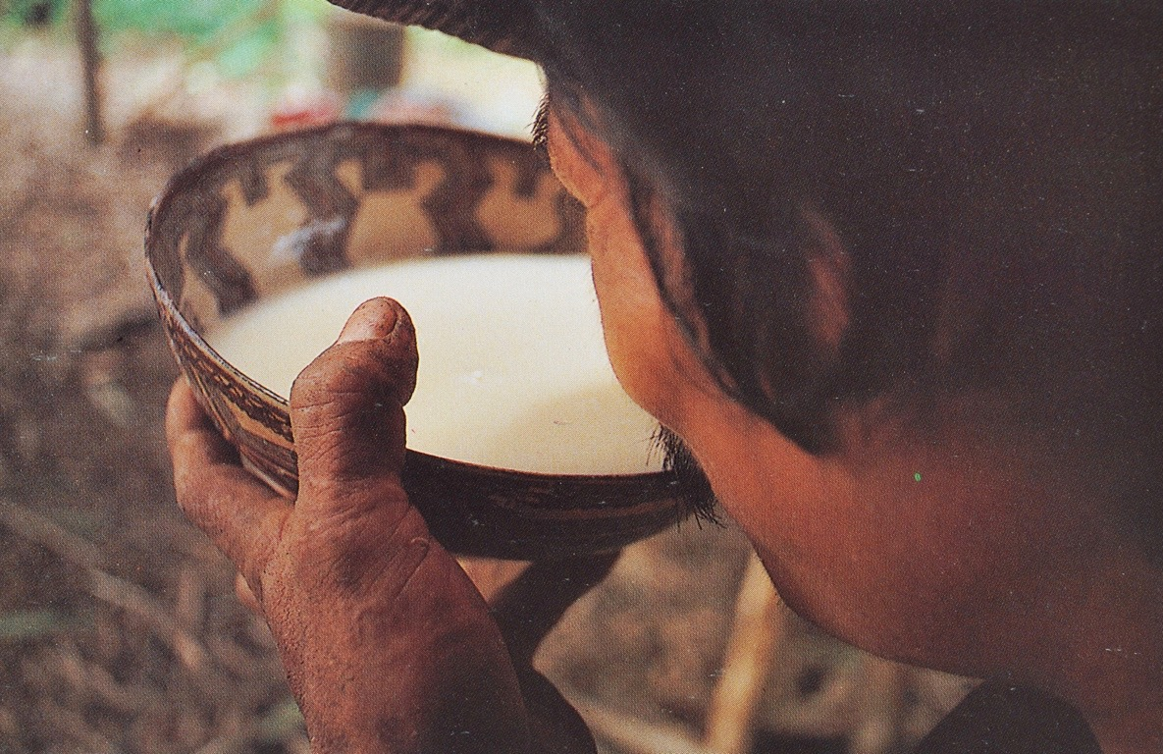
upina = to drink
I am a chicha drinker.

Slide 11
upina = to drink
Asuara upik mani

Slide 12
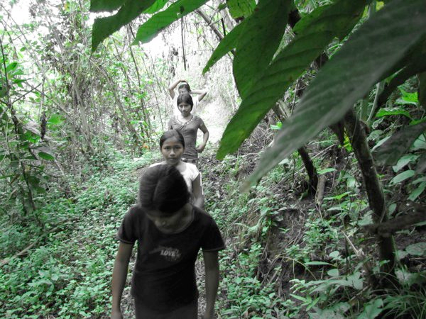
We are forest walkers.

Slide 13
Sachai purikuna manchi.
Sacha-ra purikuna manchi.
Sacha-ma purikuna manchi.

Slide 14
When the attributive –k is suffixed to verb roots it turns them into nouns which are capable of taking any suffix that a noun would take, such as pluralization. For example:
mandzhana ‘to fear’ > mandzhak ‘fear-er’> mandzhak-guna ‘the fear-ers’
purina ‘to walk, to travel, to trek’ > purik ‘walk-er, treker-er’> purikguna ‘the walkers’
Kolchonda katukuna

Slide 15
Like any noun, nouns created by adding -k can also take an object marker
Kulchunda katukuna ñukara rikunun. The mattress sellers are looking at me.
Kulchunda katukunara rikuni. I am looking at the mattress sellers.

Slide 16
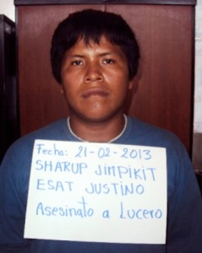
Wanchik-ta apinun.

Slide 17
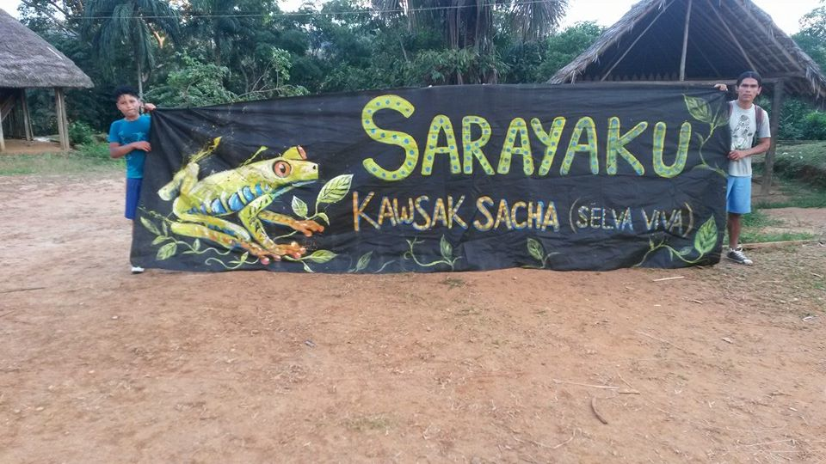
The agentive can also work as an adjective in a compound noun: wañuchik (wanchik) runa = killer man.

Slide 18
In a nominal phrase of this kind the direct object marker falls on the primary noun “runa.”
(Wañuchik)
Wanchik runa-ra apinun.
They catch the killer man.

Slide 19
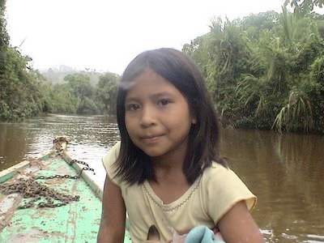
An agent in the process of doing an ongoing action is expressed by combining the durative marker with the agentive as follows:
purik > puri-u-k rikuk > rikuuk
Rikun pai.
rikuk = one who looks rikuuk = one who is looking.
“The girl who is looking at you.”
Kanda rikuuk warmi wawa.

Slide 20
The direct object marker can then be added to this combination as follows
puri-u-k-ta
Shuk warmira puriukta rikuni.
I see a woman walking.
“Amangai puñu-u-ta ama likchachingui-chu.”
Don’t wake the one who is sleeping in the hammock.

Slide 21
upina = to drink
I saw a man drinking chicha.

Slide 22
upina = to drink
Shu runara rikuni asuara upi-u-k-ta.

Slide 23
Sapura mikuukta ama killa-ch-i-chu.

Slide 24
Don’t bother the one who is eating the frog.

Slide 25
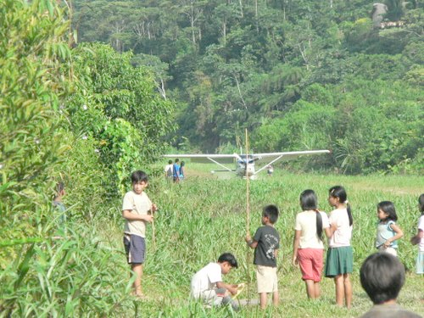
Avionetara chapakaukunara rikunchi.
Ari. Indijpi. Alli punzha tukujpi ringarauni.
Mana rijpi kiwa supai tukunga.

Slide 26
We see the kids waiting for the airplane.
Wawaunara rikunchi avionetara chapaukunata
Ari. Indijpi. Alli punzha tukujpi ringarauni.
Mana rijpi kiwa supai tukunga.

Slide 27
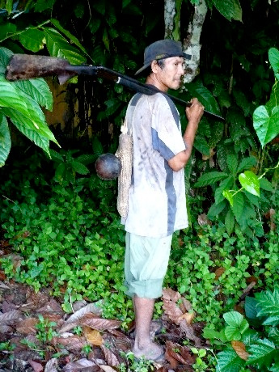
Sachama purik runa.

Slide 28
The construction -k + aka indicates habitual action and can be translated as “used to.”
Ñuka yaya sachama purik aka.
My forest used to walk in the forest.

Slide 29
My Dad used to hunt a lot (used to walk in the forest a lot.)

Slide 30
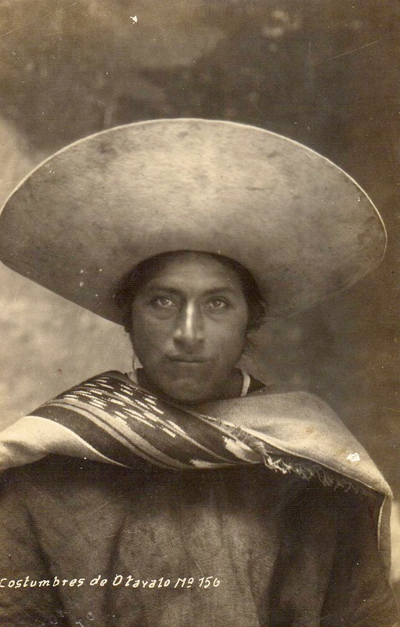
Otavaloguna ñaupa atun sobrerora churarik anauka.

Slide 31
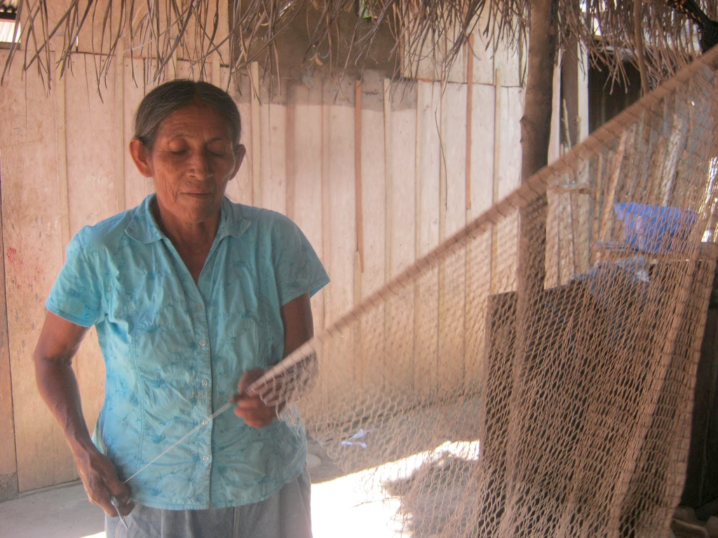
Paiwa ruku mama awak aka.

